Slide 1



Disinformation Analyzer
Architecture
i-Team A

Slide 2
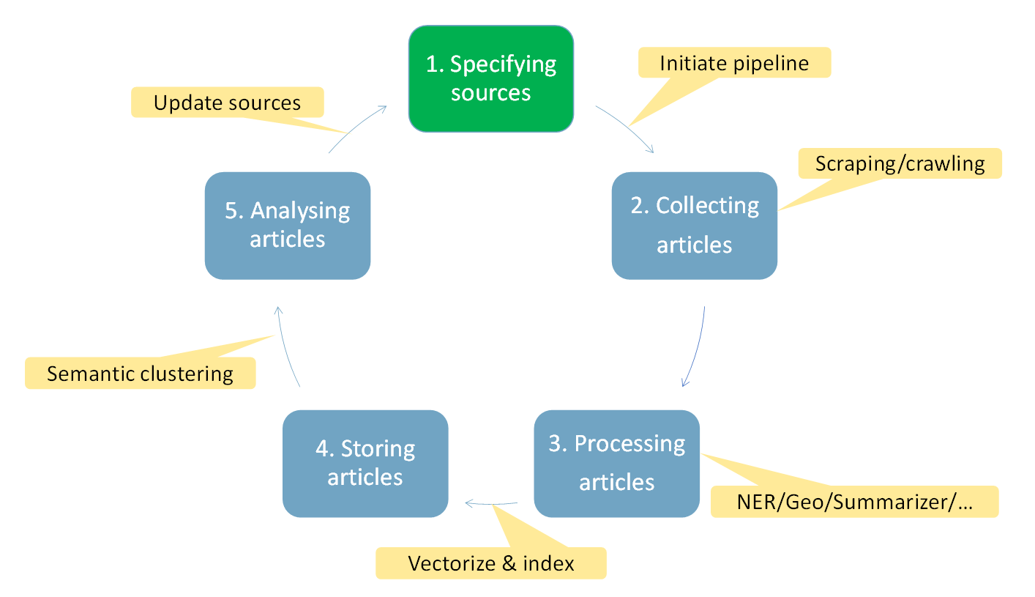
Microservices pipeline for information collection and analysis
Step 1 & 5
Step 2
Step 3
Step 4
Notes:
All services are running in Docker: for testing purposes, we run on one or two older Dell desktops with 32Gb but without GPU. All dockerized microservices and other services are connected through Apache Kafka using a single broker.
Only to communicate with the Welcome | Weaviate - vector search engine DB is through REST.
Weaviate is configured to vectorize text (i.e. create semantic word embeddings of the whole article and each paragraph), images (so we can recognize similar images), and it includes a Question & Answering service. The latter, for example, can be used to ask a question such as “Who is the current president of the US?”. However, more interestingly, it can also be used to verify the credibility of a news channel: define control questions that you know the answer of, and ask the channel to provide the answers. If there are many wrong answers, you can mark the news channel as untrustworthy.

Slide 3
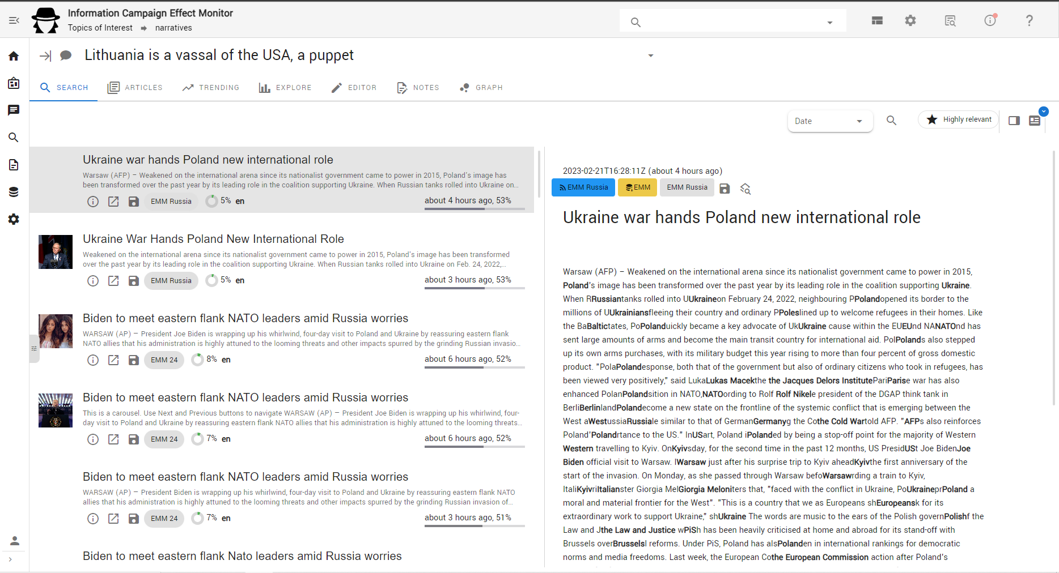
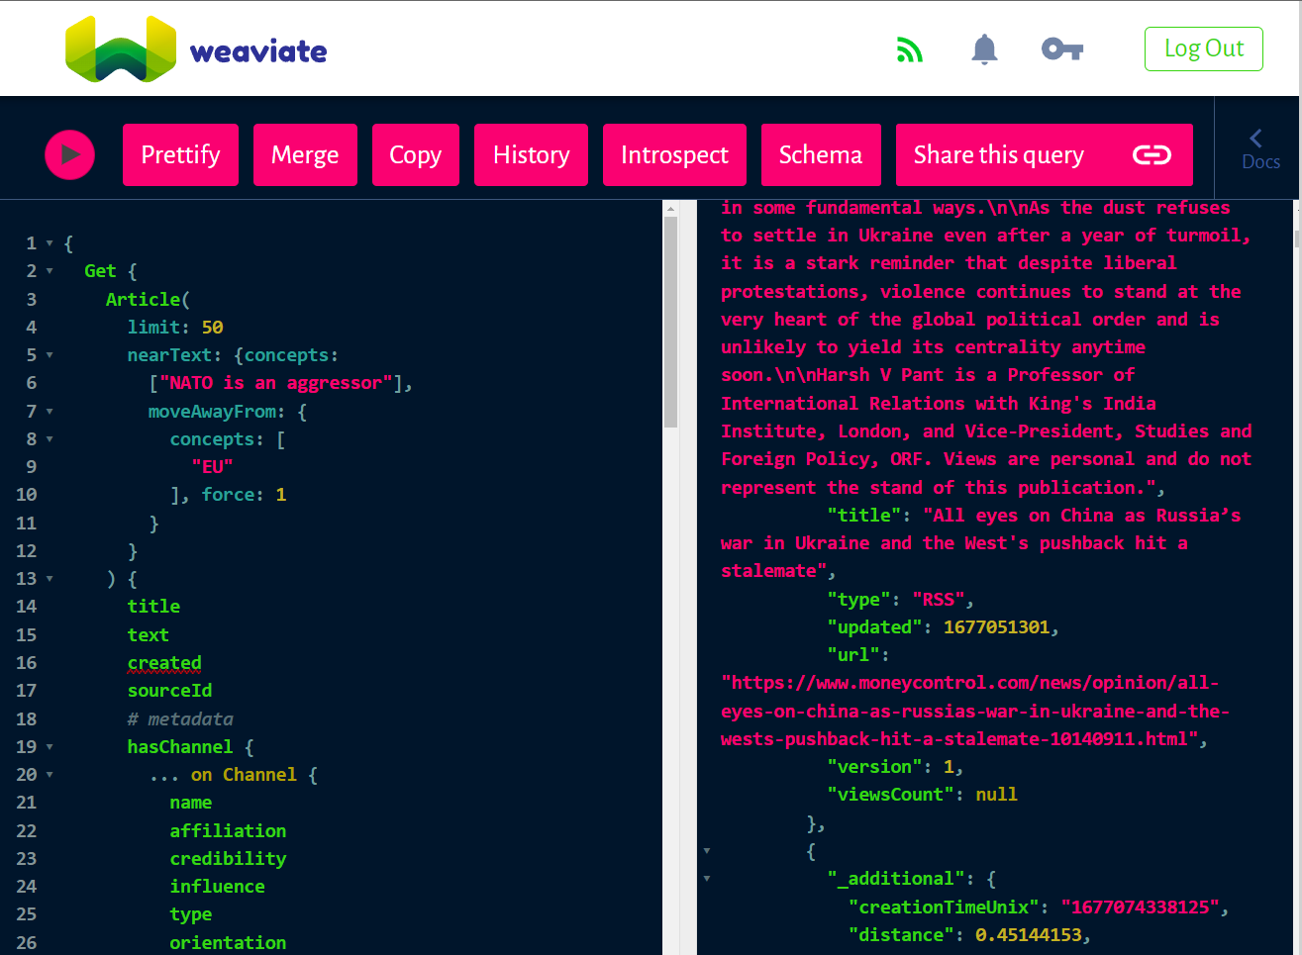
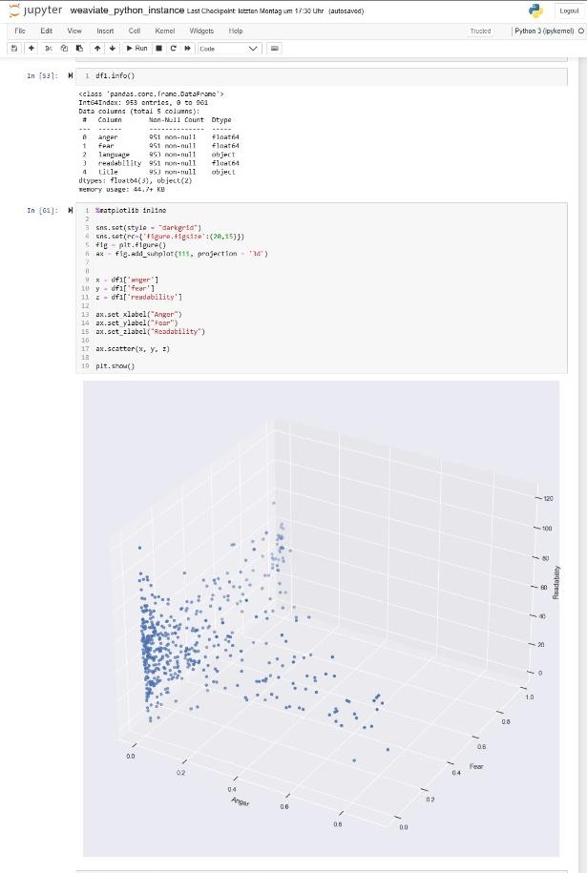
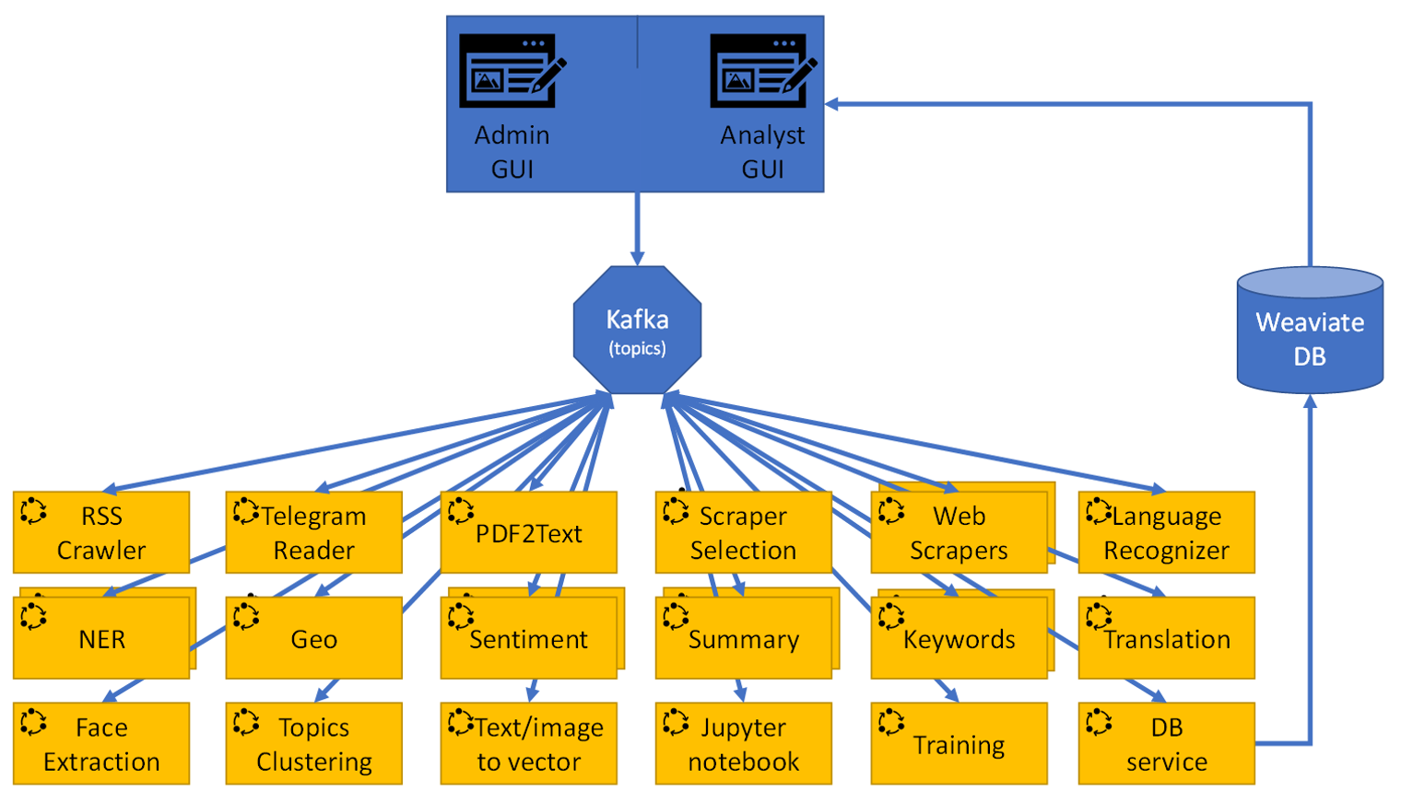

NLP services and semantic search in detail
GraphQL interface & Jupyter Notebook
Computing disinformation score using NLP:
Language detection & translation
Summarizing
Named Entity Recognition (+keywords)
Geo-tagging
Face detection
Sentiment & Emotion score
Readability score
Sarcasm/joke score
Topic clustering
Channel affiliation & credibility
Analyst Dashboard
Supports federated sharing of information (between organisations or countries)
Supports annotating disinformation content for training AI models
Notes:
Open source services and NLP models that are used:
Apache Kafka, Zookeeper and the AVRO Schema Registry: All based on the Community Edition supported by Confluent confluentinc/cp-kafka - Docker Image | Docker Hub
GUI based on TNOCS/csnext: Dashboarding starter kit for vue.js (github.com)
Adapters to easily connect to Kafka in Python, osint-python-test-bed-adapter · PyPI and/or osint-python-starter-service · PyPI, and Node.js, node-test-bed-adapter - npm (npmjs.com)
Emotion service, based on: j-hartmann/emotion-english-distilroberta-base · Hugging Face
Readability service, based on: py-readability-metrics · PyPI
Twitter service, based on: snscrape · PyPI
NER service and keywords service, based on spacy + English · spaCy Models Documentation (same for other languages)
Summary service, based on sentence-transformers/paraphrase-MiniLM-L6-v2 · Hugging Face
Translation service, using standalone version of LibreTranslate - Free and Open Source Machine Translation API
Language service, based on: franc - npm (npmjs.com)
PDF to tekst, based on: PyMuPDF · PyPI
Topics service: graphology-communities-louvain - npm (npmjs.com)
Face recognition service, based on: opencv-python · PyPI
Telegram service, based on Telethon · PyPI
Geo-service, based on geopy · PyPI

Slide 4
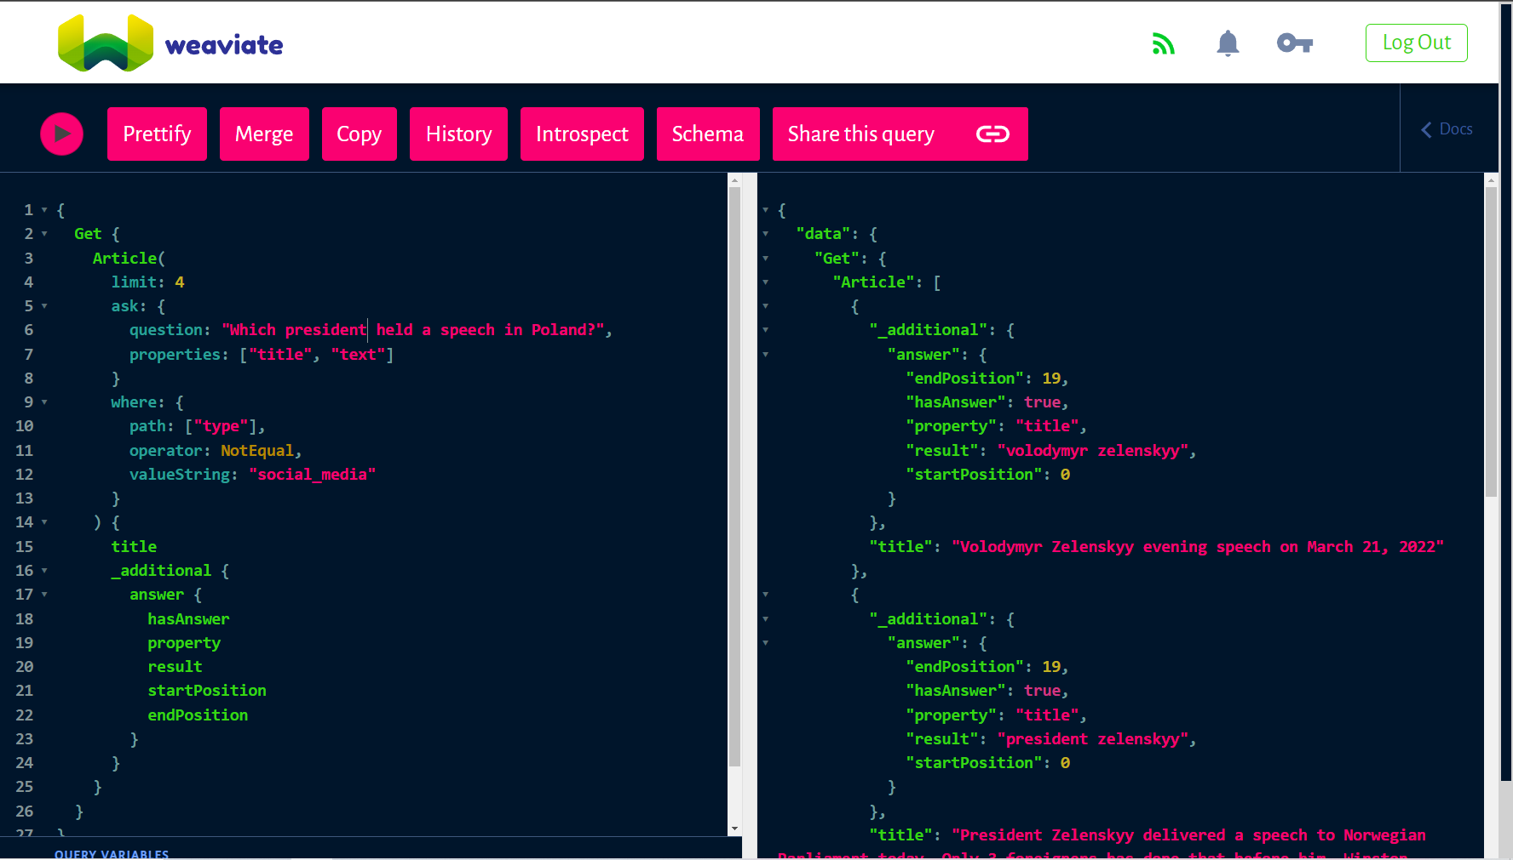
Notes:
Provided interface in GitHub.

Slide 5
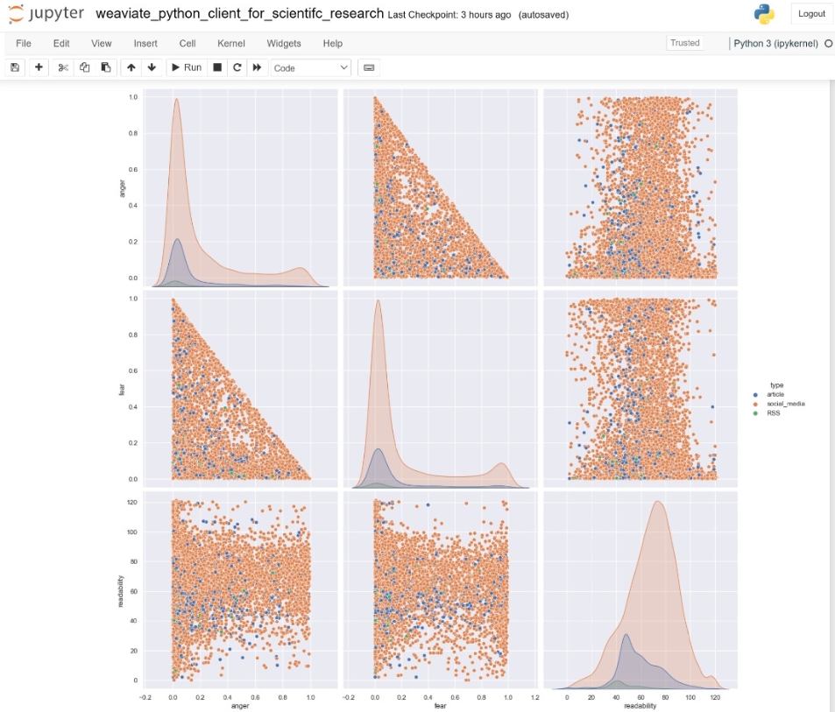

Slide 6
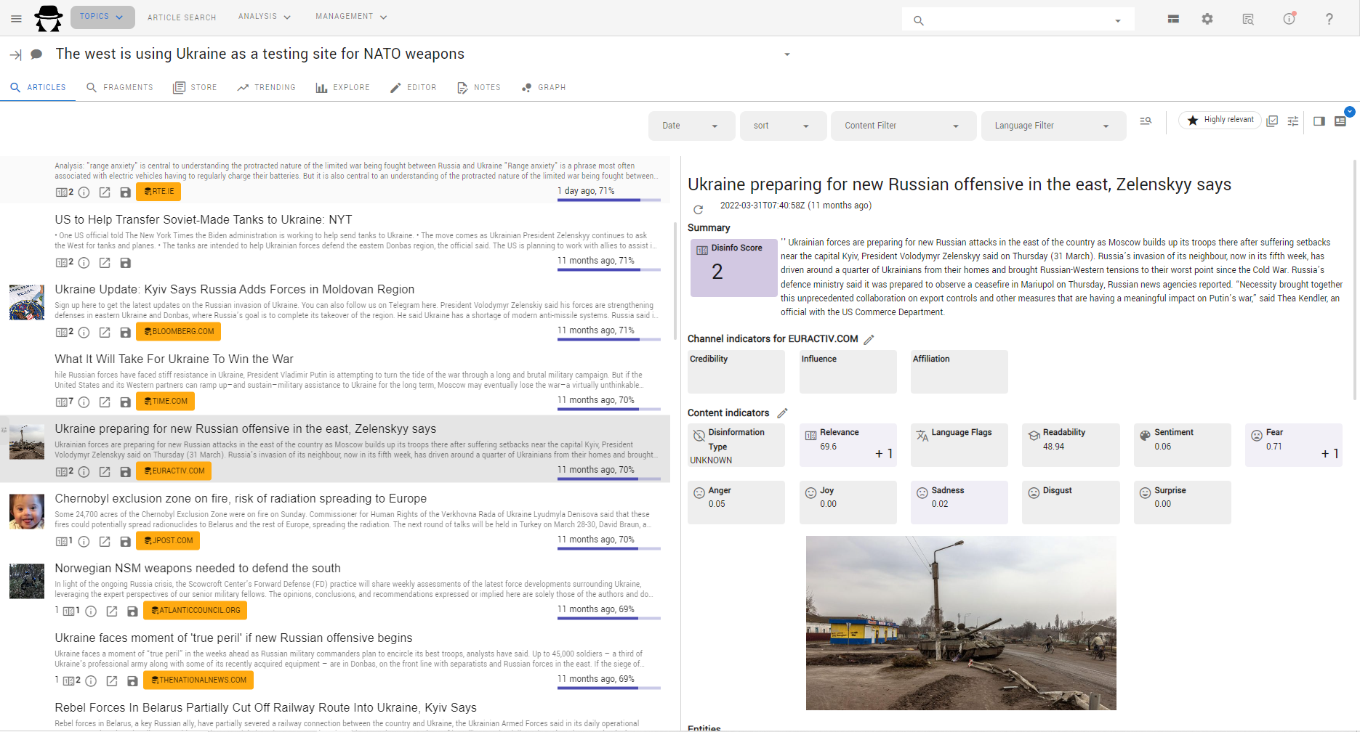

Slide 7
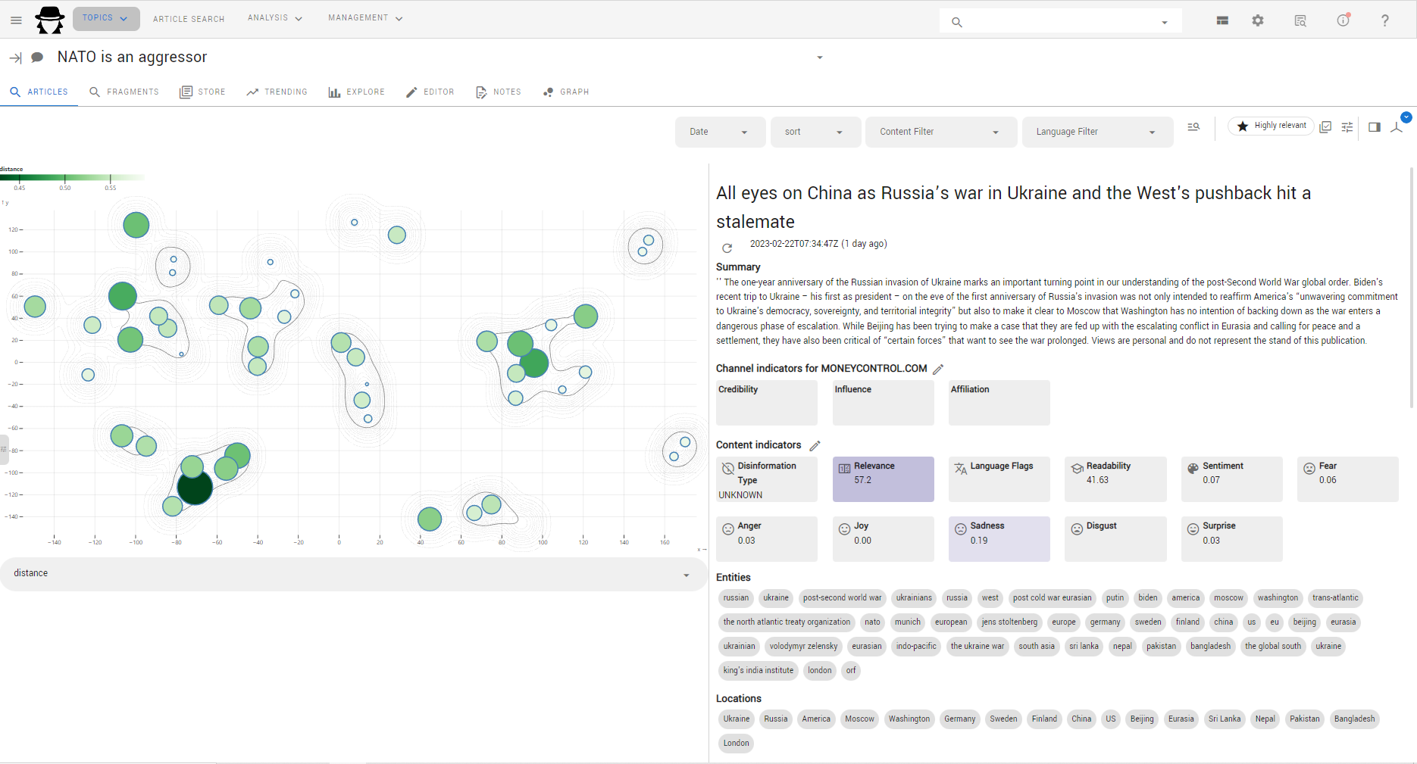

Slide 8
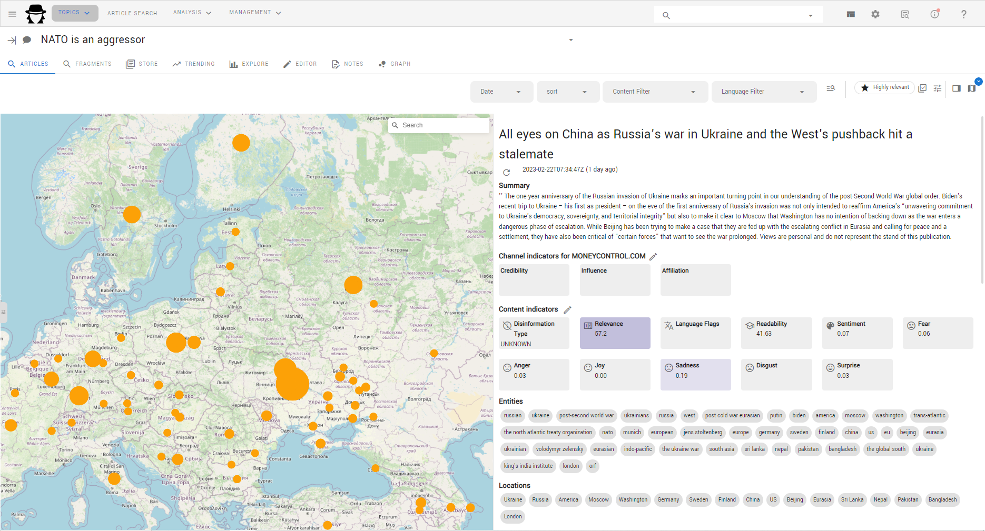

Slide 9
